Slide 1

Doctor Appointment App
Team 3
[Sanjeev, Binh, Soorna, Karthik]

Slide 2



Elevator pitch:
Easy to check Doctors’ Availability
No walk-in, save the spots for emergencies
No waiting time over the phone.
After hours booking.
Everywhere and anytime
Doctor-Appointment is a booking tool to help new and existing patients to make an appointment with their doctors.
The patients can select date for the appointment in this version.
Just a click away.

Slide 3

Concept:
Description : Using the Doctor Appointment Application, the patients both existing as well as new patients will be able to book an appointment with a GP or a specialist doctor via referral using this app. After choosing their doctor, they would be able to make an appointment with them by choosing the date as well as the time. The patient would be able to check their appointment after booking in the patient account page.
Even the Doctors will be able to check out the no of appointments in their respective login page
Motivation for development : Most of the GPs along with specialist doctors operating via clinic nowadays only use the traditional method of using either booking via telephone or there is no booking available; only able to visit your doctor using first come first serve basis. Most of the clinics usually have a working webpage which displays the basic info about the doctors, consultation timings of the clinic along with the address. By incorporating this booking feature, it will be a clean and transparent interface for both doctors as well as patients with details being shown in their respective account pages.
User story: User must be able to schedule an appointment with their doctor using this app based on the availability of the doctor and user’s own desired time. User will land on the Login/Signup page in which if the user is an existing patient he will be able to login via the credentials, if the user is a new patient; user needs to sign up using the relevant data. After logining into the app, user will be able to choose the doctor and then book an appointment by choosing the date and time along with which user will be adding description of their medical issuses.

Slide 4
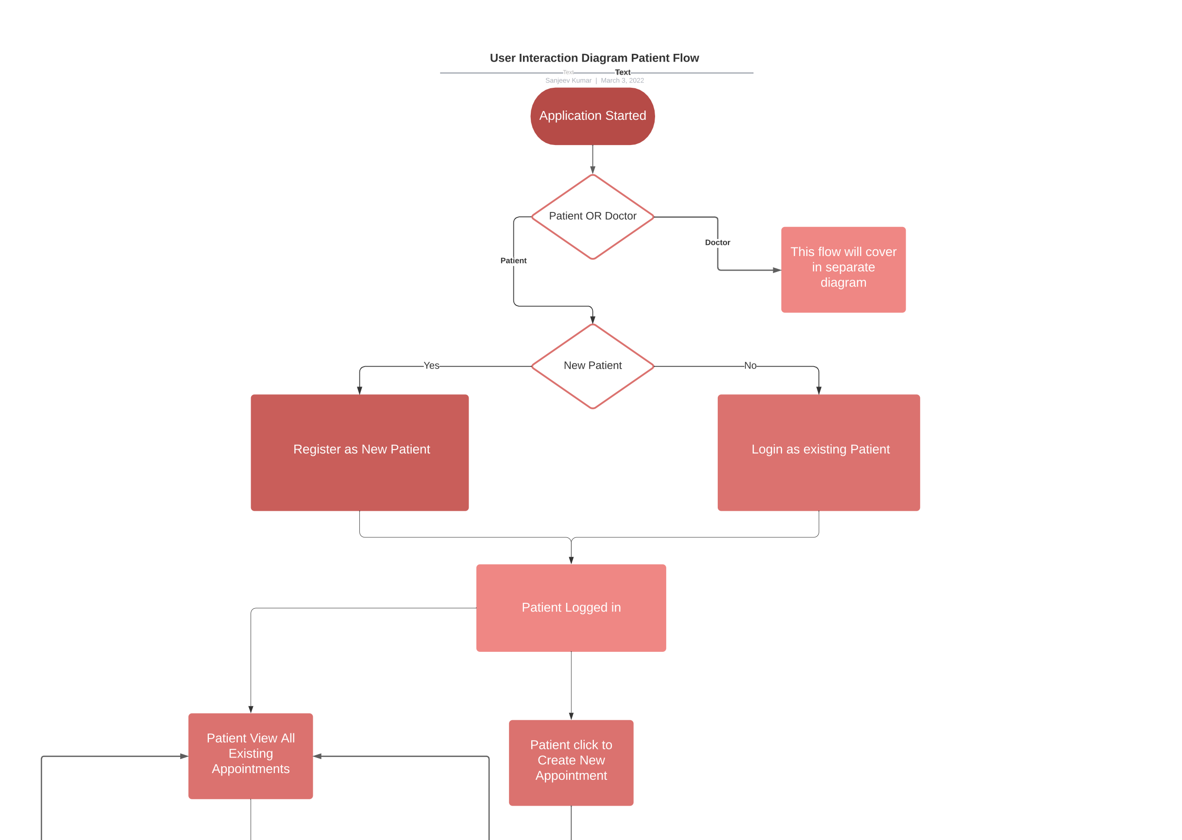
Design Process Part - 1

Slide 5
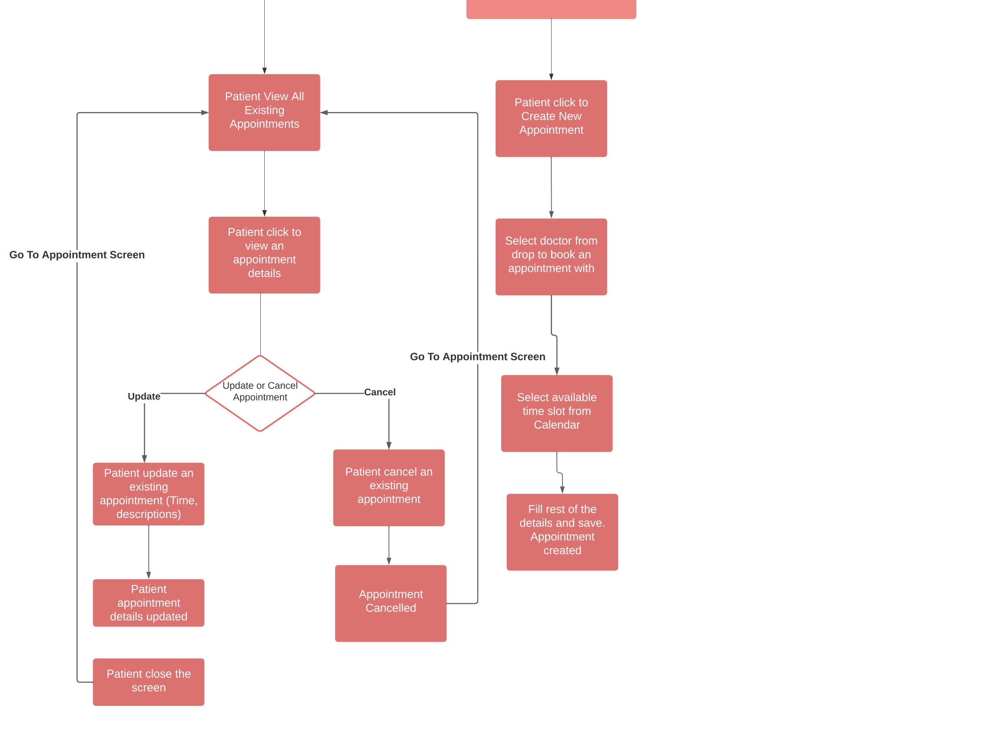
Design Process Part - 2

Slide 6
Process:
Technologies used:
Node.js, Express.js, Handlebars, SQL database, Heroku deployment, MVC, ORM, REST API, Authentication, Encryption, Express-Session, Cookies
Breakdown of tasks and roles:
Node.js and Express.js and routing function was done by Sanjeev
Databases and routing functions was done by Binh
Handlebars was done by Sorna
BA requirements, User Interaction development and HandleBars Flow was done by Karthik
Challenges:
Two weeks time-limit provided for the project proved to be bit difficult since we initially planned to add more functionalities.
Successes:
Understood the working of certain concepts by revisiting the tutorials.
Learning new things helped us finish the project successfully,
By completing this project, we gained more experience in the core concepts of the bootcamp so far.

Slide 7

Demo:

Slide 8
Directions for future development:
This Application currently only deployed for a clinic with few doctors, In future it has the option to be implemented across multiple clinics if the practice chooses to open other branches.
Doctor using their account after login page will be able to see their coming up appointments with the basic of their patient's medical history along with their referrals.
Appointment confirmation can only be viewed in the account page but in future it will come from the clinic via autogenerated e-mail as well as a text to the phone number.
Payment portals can be implemented when booking appointments.
Patients will be able to see their previous appointments in the history session of their account page

Slide 9



Links:
Deployed: https://cryptic-wave-07227.herokuapp.com/
Github Repo: https://github.com/SanjeevKumar-DEV/Doctor-Appointment

